Slide 1

Sensory Sensitivity and Sleep: Exploring the Associations between Atypical Sensory Processing and Sleep Problems in Autistic and Non-autistic Adults
Investigator: Jessie Stewart
Supervisor: Prof. Stephany Biello

Slide 2
Introduction
Atypical sensory sensitivity and sleep difficulties frequently co-occur in autistic individuals
Sleep difficulties impact physical health, mental health, and cognitive functions
Understanding the mechanisms of this relationship is vital to developing effective sleep therapies for autistic individuals
The relationship between sensory sensitivity and sleep in autistic adults has rarely been explored

Slide 3
Atypical sensory processing, although predominantly researched in the context of autism, is present in the general population
Insomnia research implicates sensory hyperarousability as a potential factor in poor sleep
Mechanisms of the relationship between sensory sensitivity and sleep in autistic and non-autistic people may thus overlap
Sleep problems are not equally related to sensitivity across all modalities

Slide 4
Objectives
Investigating the contribution of overall and specific sensory sensitivities to sleep problems in:
Diagnosed autistic adults
High autistic traits but no diagnosis
Low autistic traits
Exploratory hypotheses:
Overall sensitivity and visual sensitivity in autistic and high trait adults would predict poorer sleep than in low trait adults
Notes:
Investigated the contribution of overall and specific sensory sensitivities to sleep problems in:
adults with a diagnosis of autism
high autistic traits but no diagnosis
low autistic traits.
Exploratory hypotheses:
Overall sensitivity and visual sensitivity in autistic and high trait adults would predict poorer sleep than in low trait adults

Slide 5
Methodology
Hierarchical multiple regression to evaluate the contribution of overall and specific sensitivities on sleep problems
Low trait participants as the dummy-coded, reference group
Group interactions (e.g. Visual sensitivity x High trait) revealed significant differences in how specific sensory sensitivities affect sleep in each group

Slide 6
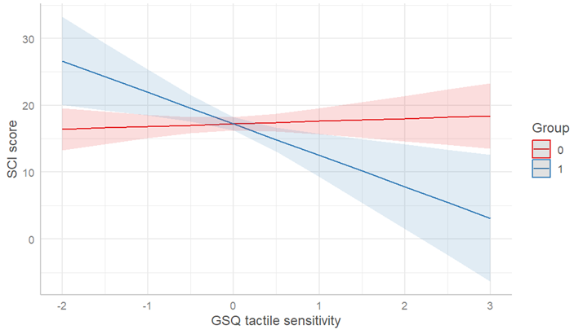
Results
Increased hyposensitivity predicted significantly poorer sleep in the autistic group compared to the low trait group
Tactile sensitivity had the same effect
Visual and gustatory sensitivity significantly predicted poor sleep in low trait individuals

Slide 7
Discussion
Tactile sensitivity and hyposensitivity may be a homogeneous sleep profile within autism, and potential mechanisms include:
- Social communication difficulties (Hohn et al., 2019)
Contrary to expectations: visual sensitivity in the autistic group did not predict poorer sleep than in the low trait group
Lack of specific differences in high trait individuals highlights that autistic traits differ from autism qualitatively as well as quantitatively
Sensitivities found in low trait individuals align with previous physiological evidence of increased functional connectivity in insomnia
Group focus may overlook individual differences and transdiagnostic mechanisms

Slide 8
Limitations
Comparison of unmatched, uneven groups
Use of self-report questionnaires hinders participation of some autistic individuals (eg non-verbal adults, requires internet use) and thus is not representative of the whole spectrum
Poor to acceptable Cronbach’s scores on some of the sub-sections of the Glasgow Sensory Questionnaire due to having only three items
- Longer questionnaires are necessary to assess specific sensitivities more accurately

Slide 9
Conclusions
Sleep disturbances are mainly associated with visual and gustatory sensitivity in low trait individuals
Hyposensitivity and touch sensitivity lead to significantly poorer sleep in autistic adults compared to low trait adults.
Identifying homogeneity within autism is important to develop targeted interventions for sleep problems

Slide 10
Future Directions
Further studies to confirm these effects in a larger sample, and to examine mechanisms with objective measures
Recommendation: stratifying individuals based on sensory sensitivity and/or sleep problems rather than diagnosis alone

